Slide 1
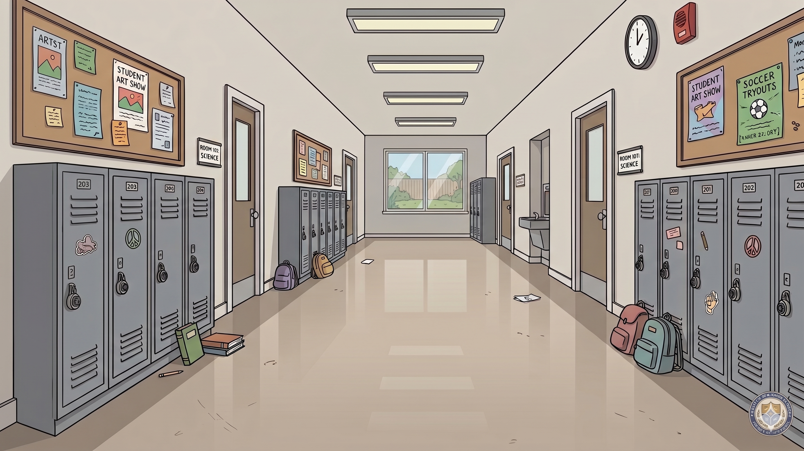
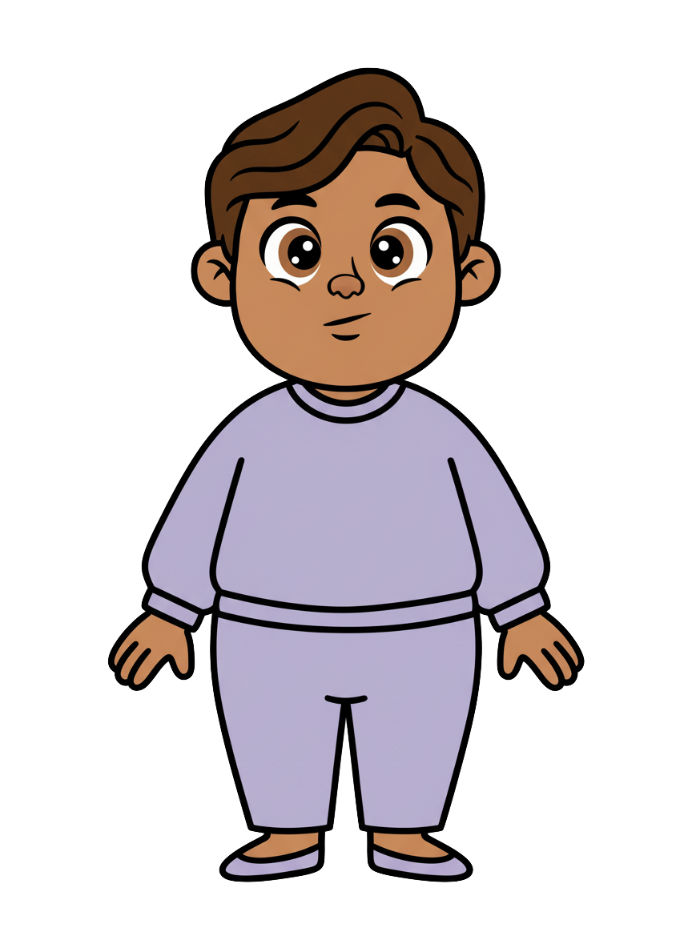
This is Milo.

Slide 2
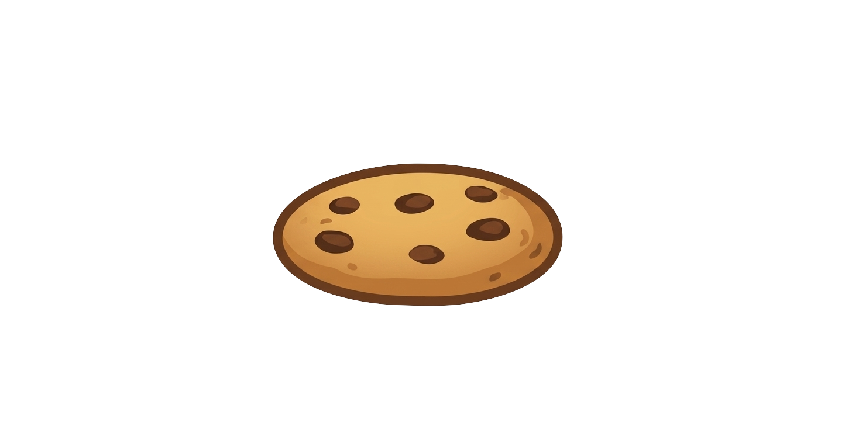
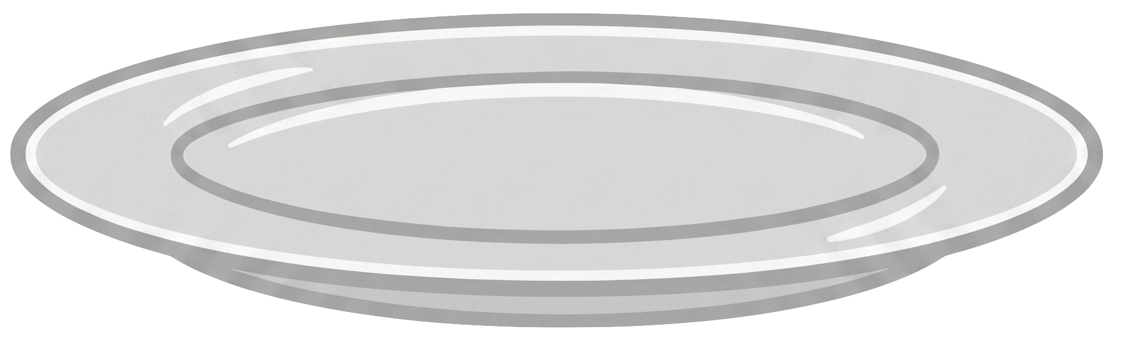
Milo has 5 cookies.

Slide 3
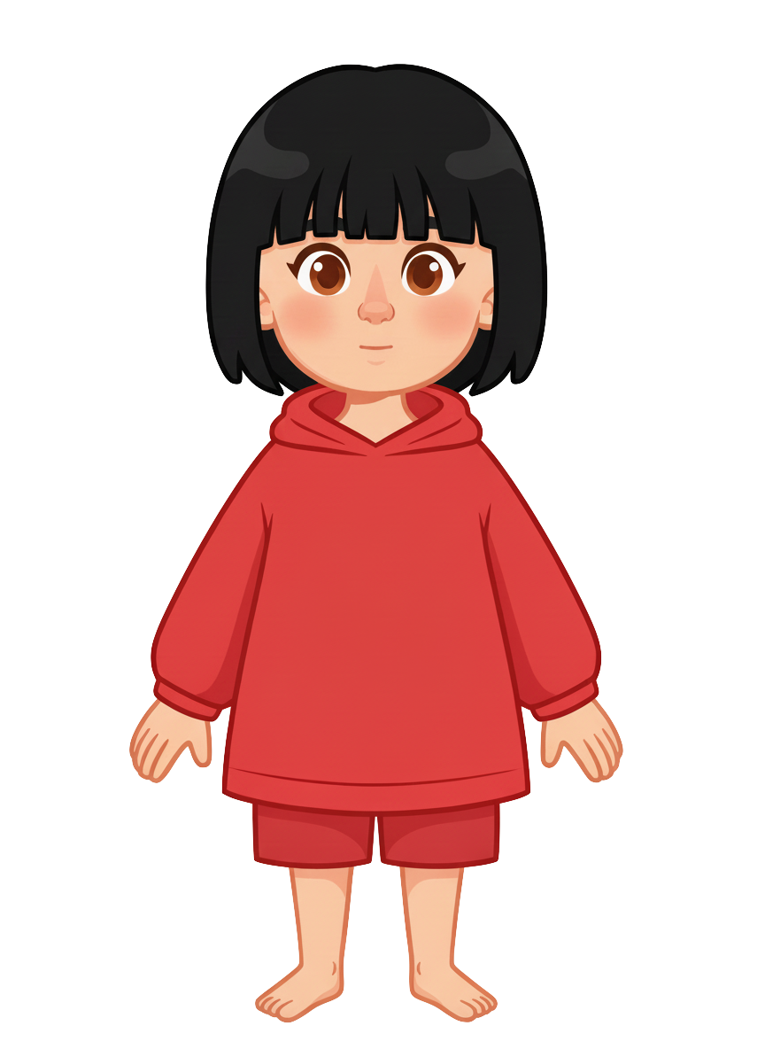
This is Sasha.

Slide 4
Sasha has 2 cookies.

Slide 5
Sasha puts her cookies on the ground.

Slide 6
Sasha walks away from her cookies.

Slide 7
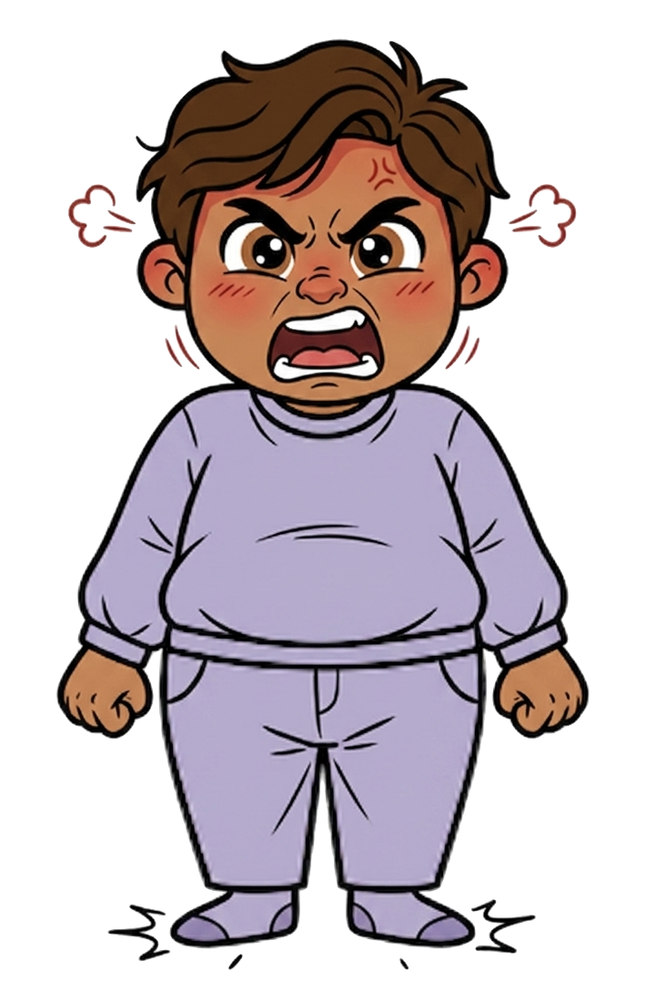
Milo is angry.

Slide 8
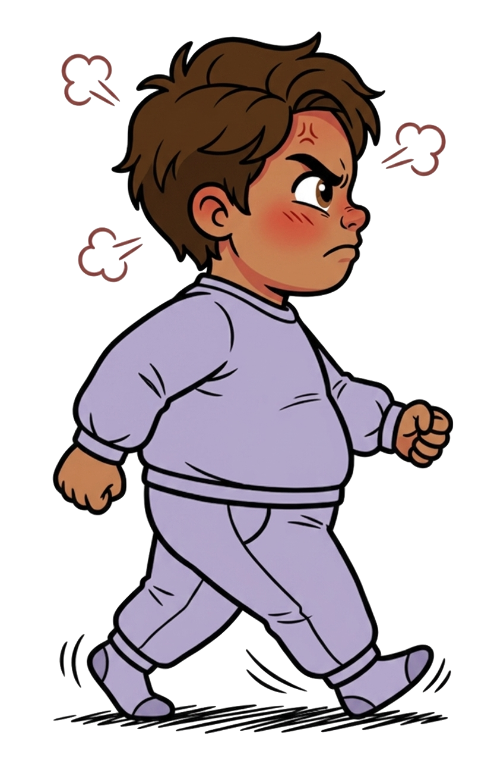
He walks over.

Slide 9
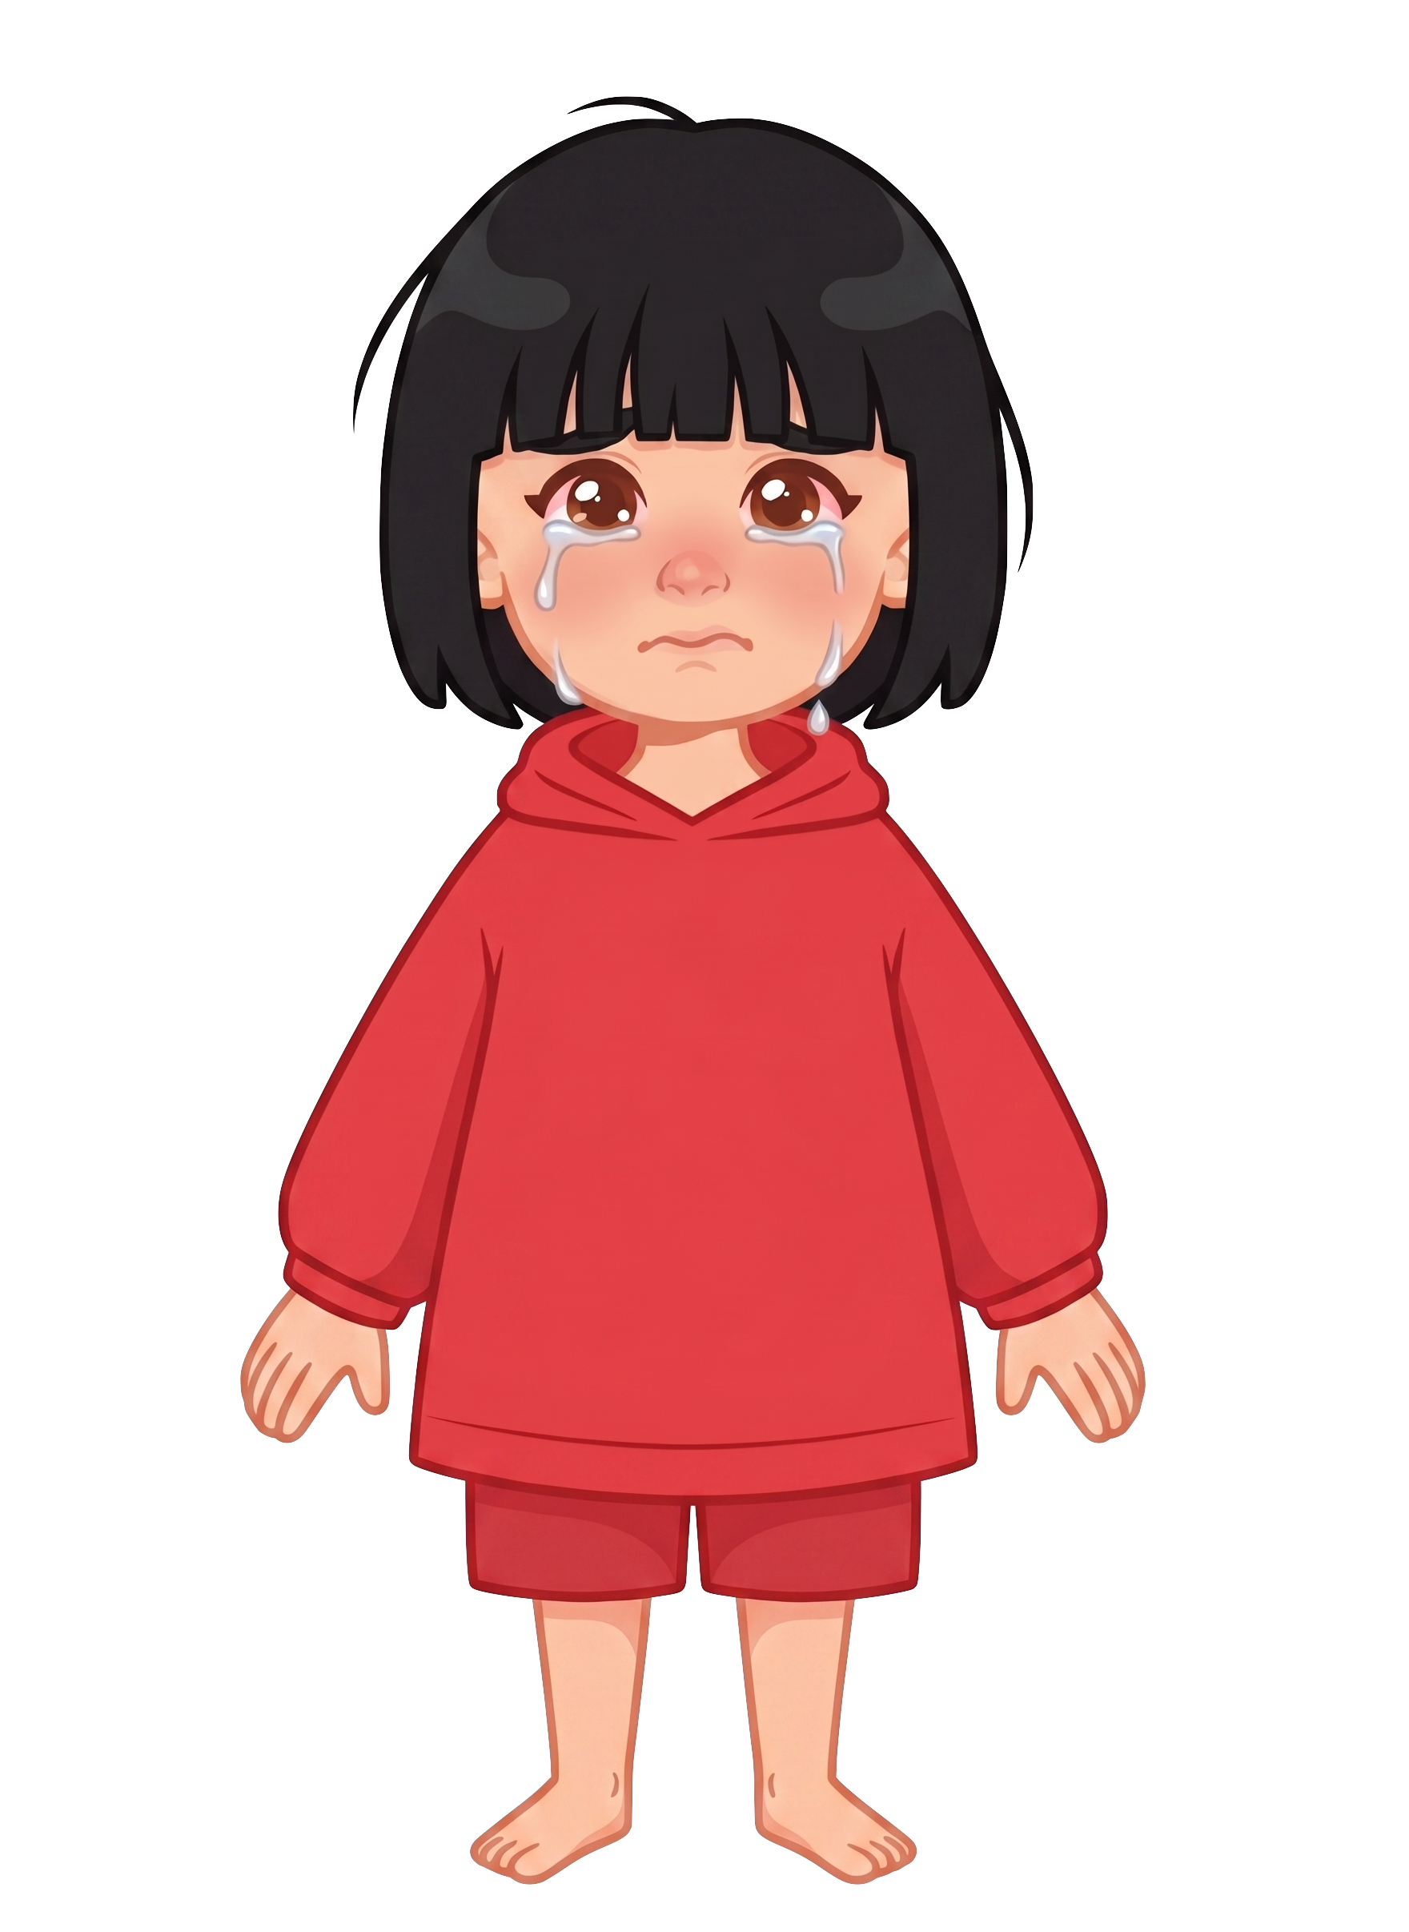
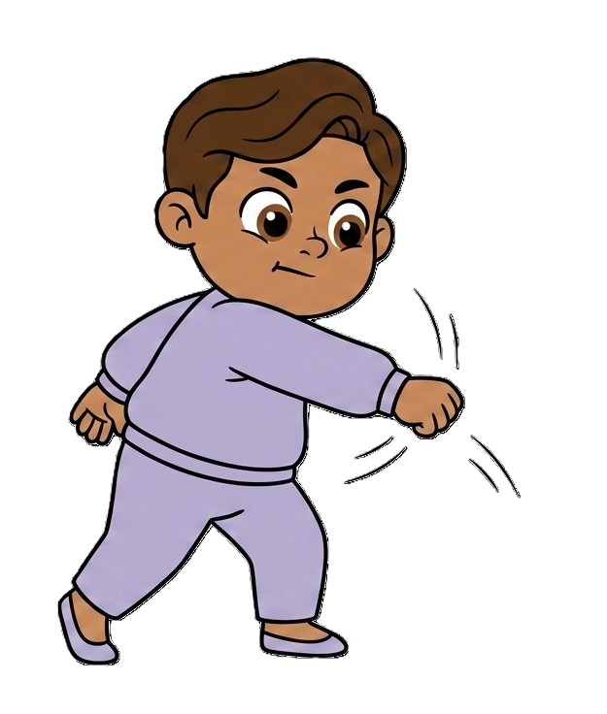
And hits 2 of Sasha’s cookies!

Slide 10
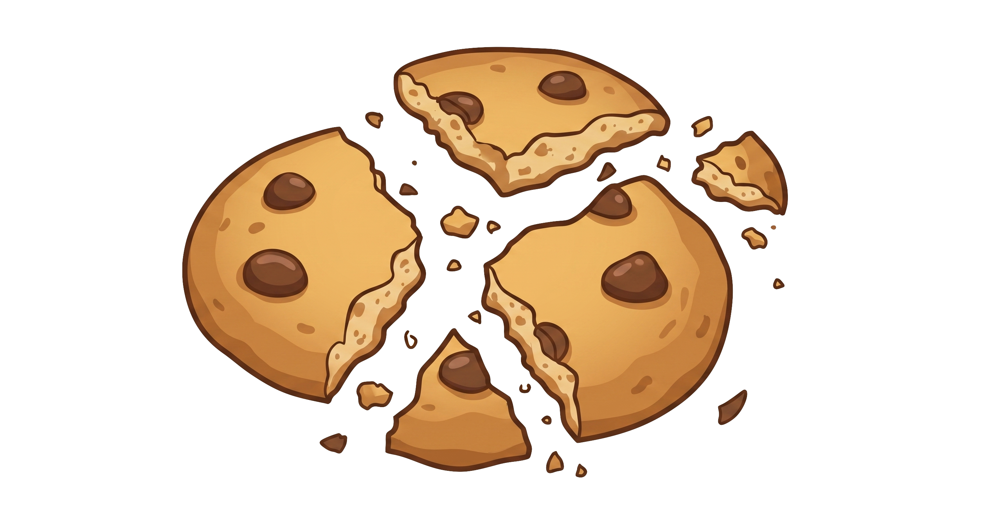
Milo still has 5 cookies. Sasha now has 0 cookies.

